Slide 1

Predicting Customers Buying Behaviour
By Islam Omar
12/17/2023

Slide 2
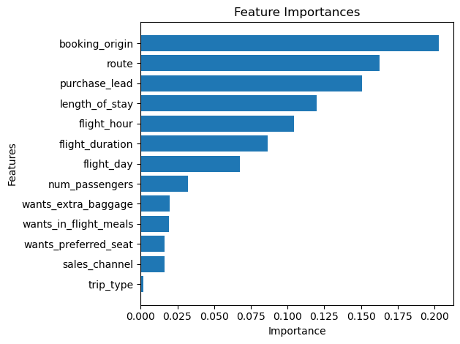
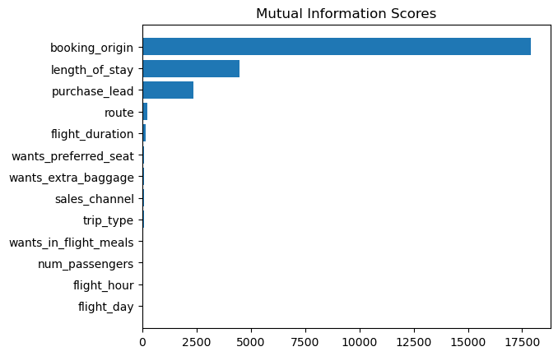
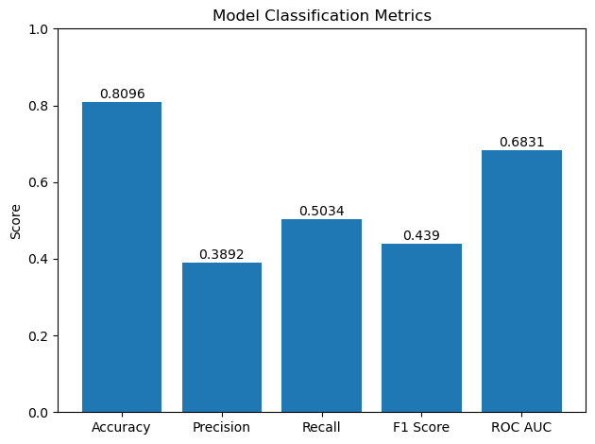
Feature Importances & Classification Model Metrics and Findings
Classification Report
 | precision | recall | f1-score | support
0 | 0.91 | 0.86 | 0.89 | 8520
1 | 0.39 | 0.50 | 0.44 | 1480
accuracy |  |  | 0.81 | 10000
macro avg | 0.65 | 0.68 | 0.66 | 10000
weighted avg | 0.83 | 0.81 | 0.82 | 10000
Accuracy: 0.8096
Precision: 0.3892
Recall: 0.5034
F1 Score: 0.4390
ROC AUC: 0.6831

